Slide 1
Diabetes
Dashboard
Using power bi

Slide 2
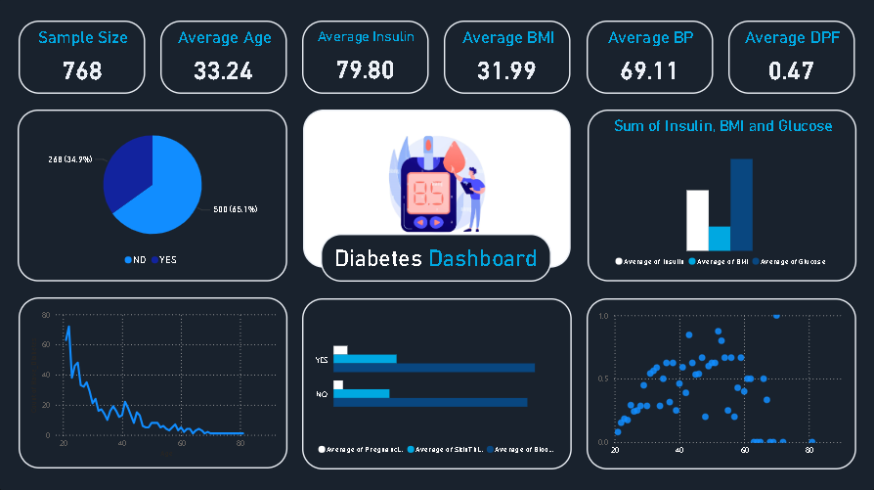

Slide 3


Some numbers
T
4

Slide 4
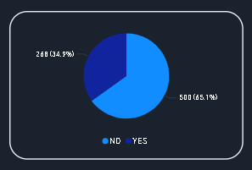
Is the person diabetic?
T
4

Slide 5
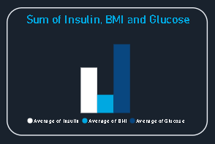
T
5

Slide 6
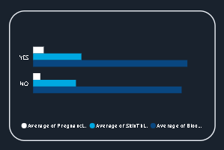
Is the person diabetic?
T
6

Slide 7
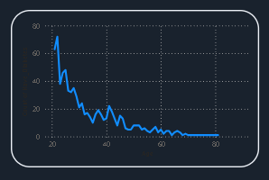
Age distribution
T
6

Slide 8
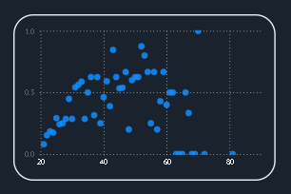
Age vs diabetes
T
6

Slide 9
Thanks!
Do you have any questions?

